Slide 1
Cloud Services
By: Hermawan

Slide 2
Cloud Computing & Web-Service
Cloud computing a set of Internet-based application, storage and computing services sufficient to support most users’ needs, thus enabling them to largely or totally dispense with local data storage and application software.
Web services also provide the underlying middleware for both the Grid and cloud computing.

Slide 3
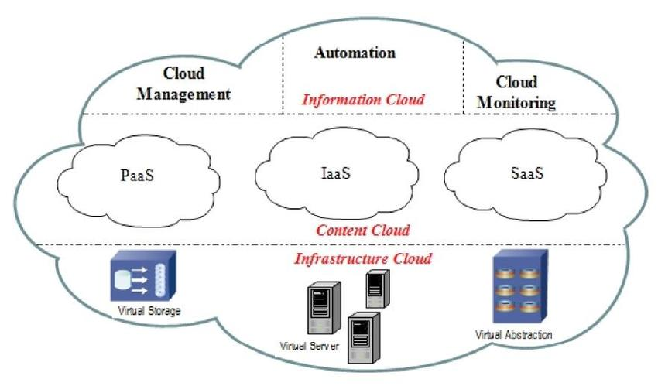
Cloud Computing

Slide 4
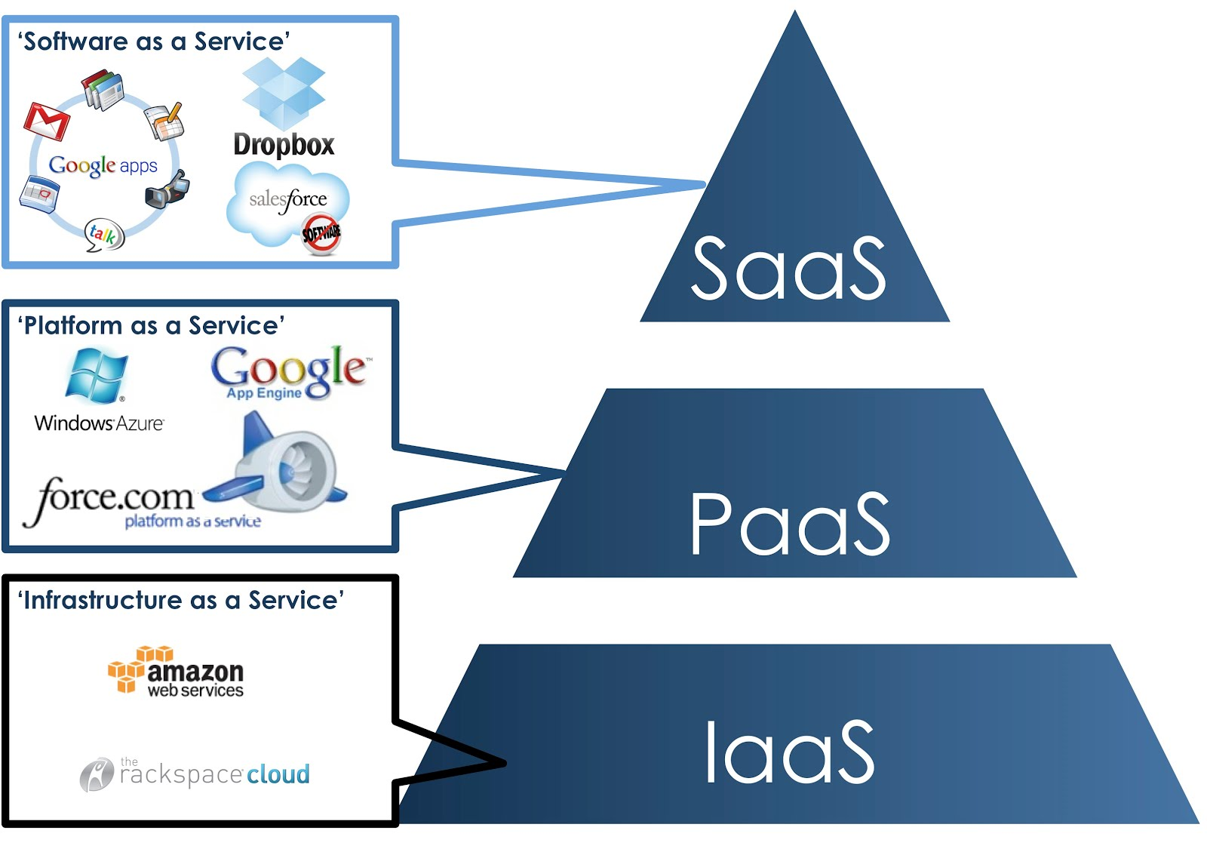
Cloud Computing

Slide 5
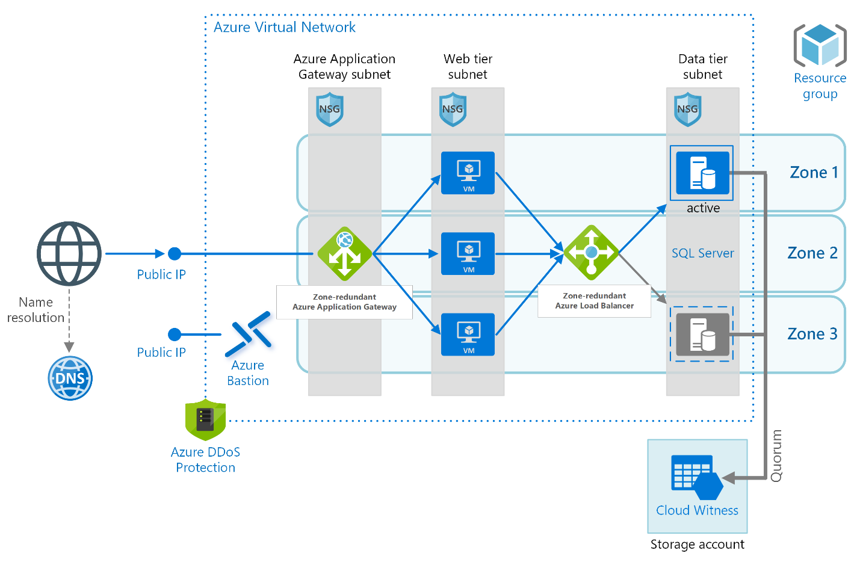
Cloud Computing 1. IaaS
IaaS, Infrastructure as a service (IaaS) is a type of cloud computing service that offers essential compute, storage, and networking resources on demand.

Slide 6
Cloud Computing 1. IaaS
IaaS Characteristics include:
Resources are available as a service
Cost varies depending on consumption
Services are highly scalable
Multiple users on a single piece of hardware
Organization retain complete control of the infrastructure
Dynamic and flexible

Slide 7
Cloud Computing 1. IaaS
IaaS tenant providers:
gitalOcean
Linode
Rackspace
Amazon Web Services (AWS)
Cisco Metacloud
Microsoft Azure
Google Compute Engine (GCE)

Slide 8
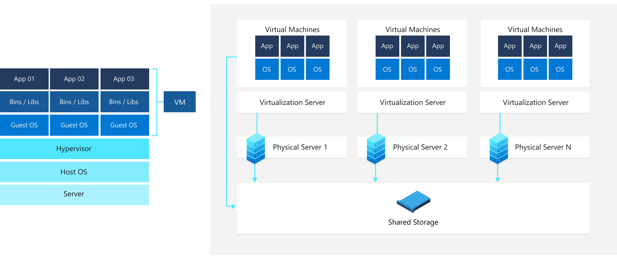
Cloud Computing IaaS Core: Virtualization OS and Network

Slide 9
Cloud Computing IaaS Core: Virtualization OS and Network
Skype Virtualization Network

Slide 10
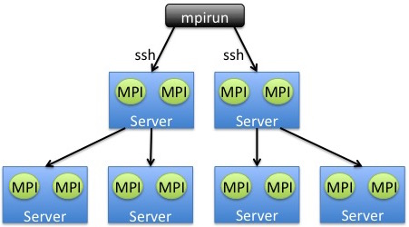
Cloud Computing IaaS Parallel CPU
Message Passing Interface (MPI)
Grid Computing for IaaS

Slide 11
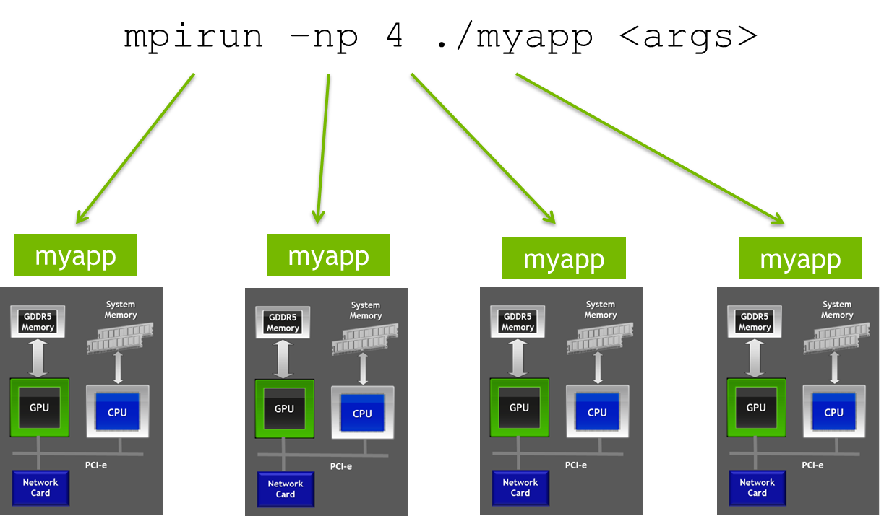
Cloud Computing IaaS Parallel CPU-GPU
Message Passing Interface (MPI)
Grid Computing for IaaS accelerated with GPU

Slide 12
Cloud Computing 2. PaaS
PaaS, provide cloud components to certain software while being used mainly for applications.
Characteristics include:
Builds on virtualization technology, so resources can easily be scaled up or down as your business changes
Provides a variety of services to assist with the development, testing, and deployment of apps
Accessible to numerous users via the same development application
Integrates web services and databases

Slide 13
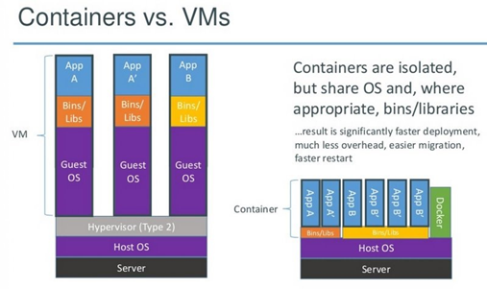
Cloud Computing IaaS-Paas Core: Virtualization & Container

Slide 14
Cloud Computing 2. PaaS
PaaS Tenant Providers:
AWS Elastic Beanstalk
Windows Azure
Heroku
Force.com
Google App Engine
OpenShift

Slide 15
Cloud Computing 3. SaaS
Software as a Service (SaaS), also known as cloud application services, represents the most commonly utilized option for businesses in the cloud market.
In generally, SaaS are managed by a third-party vendor, to its users.
SaaS Tenant Providers:
Google Workspace
Google Class
PlayStore
Dropbox
Salesforce
Cisco WebEx
SAP Concur
GoToMeeting
On-Line Games: PUBG, ROBLOX, etc

Slide 16
Design Basic Cloud Distributed System IaaS-PaaS-SaaS
RPC
Web
Web-Service
File Document
BPMN
SaaS
Business Process Management System
PaaS
Docker Stack Container
Virtual BOX
IaaS
Open-MPI
Open-MPI
Open-MPI
Open-MPI
Open-MPI
Open-MPI

Slide 17
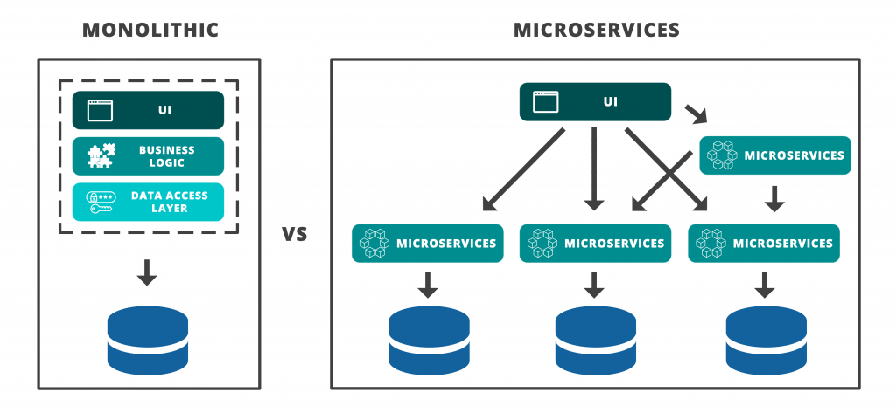
Design SaaS Cloud
Trend Micro-Services

Slide 18
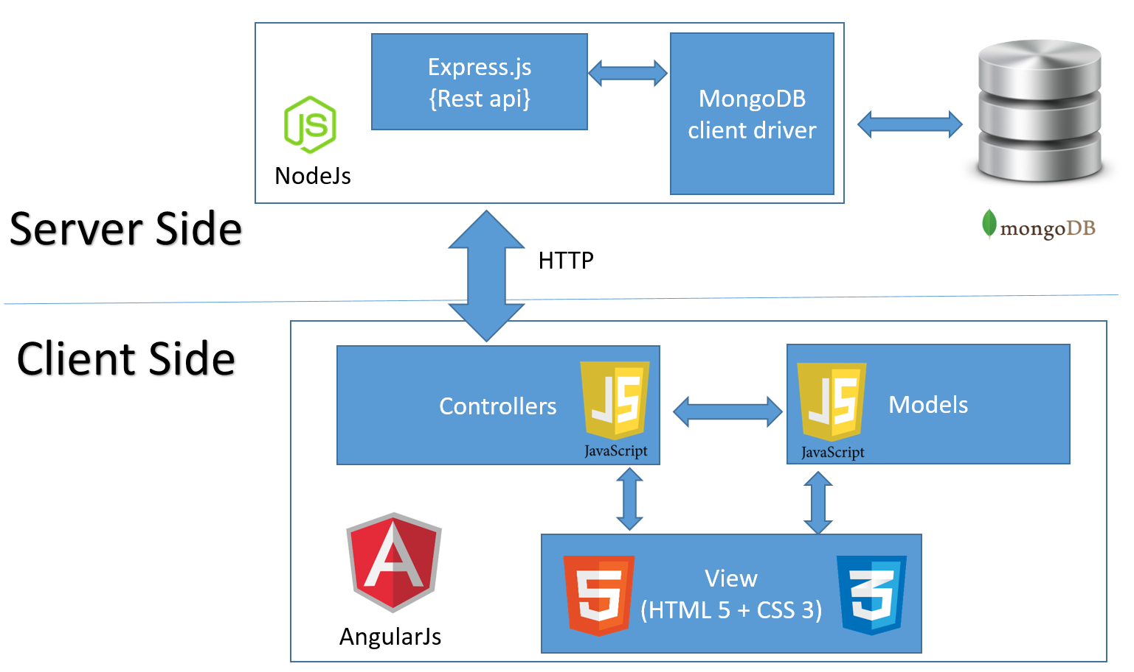
Design SaaS Cloud
N-Tire Micro-Services

Slide 19
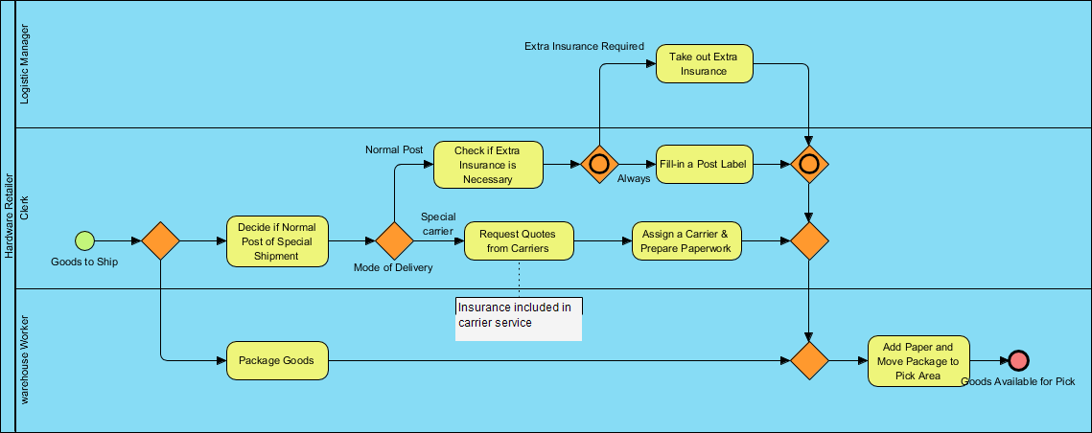
Design SaaS Cloud Composition Services in SOA
Orchestration
Business Service
Aggregate DOMAIN Web-service
Component Service
Atomic
Service
Atomic
Service
Atomic
Service
Atomic
Service
Atomic
Service
Atomic
Service
Component Service
Atomic
Service
Atomic
Service
Atomic
Service
Atomic
Service
Atomic
Service
Atomic
Service
Component Service
Atomic
Service
Atomic
Service
Atomic
Service
Atomic
Service
Atomic
Service
Atomic
Service

Slide 20
Team Works Project
Create Design and Implementation Basic Cloud with your team
Create minimum 3 domain service/ 3 package application software
Expose your domain as a web-service using Rest or SOAP
Implement Orchestration service use Event-Driven Service by consuming the web-services.

